Slide 1
SOLID PRINCIPLES
Sameer Maniyar

Slide 2
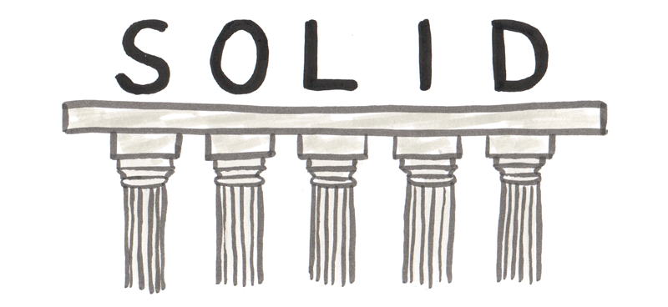
[S]ingle Responsibility Principle
[O]pen/Closed Principle
[L]iskov Substitution Principle
[I]nterface Segregation Principle
[D]ependency Inversion Principle

Slide 3
S -Single Responsibility Principle - should have only one reason to change
class User { ​
void CreatePost(Database db, string postMessage) { ​
try ​{
db.Add(postMessage);
} catch (Exception ex) ​{
db.LogError("An error occured: ", ex.ToString());
File.WriteAllText("\LocalErrors.txt", ex.ToString());
}
} ​
} ​
class Post {​
private ErrorLogger errorLogger = new ErrorLogger();
void CreatePost(Database db, string postMessage)​ {​
try​ {​
db.Add(postMessage);
}​ catch (Exception ex)​ {​
errorLogger.log(ex.ToString())​
}​
}​
}​
class ErrorLogger {​
void log(string error)​ {​
db.LogError("An error occured: ", error);
File.WriteAllText("\LocalErrors.txt", error);
}​
}​

Slide 4
O — Open/closed principle
should be open for extensions but closed for modification.
class Post {
void CreatePost(Database db, string postMessage) {
if (postMessage.StartsWith("#")) {
db.AddAsTag(postMessage);
} else {
db.Add(postMessage);
}
}
}
class Post {
void CreatePost(Database db, string postMessage) {
db.Add(postMessage);
}
}
class TagPost extends Post {
@Override
void CreatePost(Database db, string postMessage) {
db.AddAsTag(postMessage);
}
}

Slide 5
L — Liskov substitution principle
Derived classes must be substitutable for their base classes.
class MentionPost extends Post {
void createMentionPost(Database db, string postMessage) {
string user = postMessage.parseUser();
db.NotifyUser(user);
db.OverrideExistingMention(user, postMessage);
base.CreatePost(db, postMessage);
}
}
class MentionPost extends Post {
void createPost(Database db, string postMessage) {
string user = postMessage.parseUser();
NotifyUser(user);
OverrideExistingMention(user, postMessage)
base.CreatePost(db, postMessage);
}
}

Slide 6
I — Interface segregation principle
many specific interfaces are better than a general interface
interface IPost {
void CreatePost();
}
interface IPostNew {
void CreatePost();
void ReadPost();
}
interface IPostCreate {
void CreatePost();
}
interface IPostRead {
void ReadPost();
}
Design Principle
Identify the aspects of your application that vary and separate them from what stays the same, take the parts that vary and encapsulate them, so that later you can alter or extend the parts that vary without affecting those that don’t.

Slide 7
D - Dependency inversion principle
way to decouple entities in the system
High-level modules should not depend on low-level modules. Both should depend on abstractions.
class Post {
private ErrorLogger errorLogger = new ErrorLogger();
void CreatePost(Database db, string postMessage) {
try {
db.Add(postMessage);
} catch (Exception ex) {
errorLogger.log(ex.ToString())
}
}
}
class Post {
private Logger _logger;
public Post(Logger injectedLogger) {
_logger = injectedLogger;
}
void CreatePost(Database db, string postMessage) {
try {
db.Add(postMessage);
} catch (Exception ex) {
logger.log(ex.ToString())
}
}
}

Slide 8
D - Dependency inversion principle- cont.
way to decouple entities in the system
Design Principle
Program to an interface, not an implementation.

Slide 9
Duck Simulator
abstract class Duck {
public void quack() {
}
public void swim() {
//swim logic
}
public abstract void display();
}
class RedHeadDuck extends Duck {
display() {
// looks like a readHead
}
class WhiteHeadDuck extends Duck {
display() {
// looks like a whiteHead
}
}

Slide 10
New requirement – flying ducks
How are we going to handle?
Add fly to super class
Add empty body in sub classes
Have different interfaces for flyable

Slide 11
How should duck look like now?
Design Principle
Favor composition over inheritance
With this design, other types of objects can reuse our fly and quack behaviors because these behaviors are no longer hidden away in our Duck classes!
And we can add new behaviors without modifying any of our existing behavior classes or touching any of the Duck classes that use flying behaviors.
Strategy – changing the implementation at the run time, have different algorithms implemented and encapsulate each one into one class and pick them at run time, this gives you the flexibility of changing the implementation without affecting the client which is using it
public abstract class Duck {
FlyBehavior flyBehavior;
QuackBehavior quackBehavior;
public abstract void display();
public void performFly() { flyBehavior.fly();
}
//Delegate to the behavior class
public void performQuack() { quackBehavior.quack();
}
public void swim() {
System.out.println(“All ducks float, even flying ones”);
}
}

Slide 12
THANKS!
Does anyone have any questions?
sameer.maniyar@flipkart.com

